Slide 1
Introduction

Slide 2
What is PHP?
PHP (Hypertext Preprocessor)
is a widely-used open source general-purpose scripting language that is especially suited for web development and can be embedded into HTML.

Slide 3
Example #1 An introductory example
<!DOCTYPE HTML> <html> <head> <title>Example</title> </head> <body> <?php echo "Hi, I'm a PHP script!"; ?> </body> </html>

Slide 4
What is PHP?
Instead of lots of commands to output HTML (as seen in C or Perl), PHP pages contain HTML with embedded code that does "something" (in this case, output "Hi, I'm a PHP script!").
The PHP code is enclosed in special start and end processing instructions <?php and ?> that allow you to jump into and out of "PHP mode."
What distinguishes PHP from something like client-side JavaScript is that the code is executed on the server, generating HTML which is then sent to the client. The client would receive the results of running that script, but would not know what the underlying code was.

Slide 5
What is PHP?
The best things in using PHP are that it is extremely simple for a newcomer, but offers many advanced features for a professional programmer.
Although PHP's development is focused on server-side scripting, you can do much more with it.

Slide 6
What can PHP do?
Anything.
PHP is mainly focused on server-side scripting, so you can do anything any other CGI program can do, such as:
collect form data, generate dynamic page content, or send and receive cookies.
But PHP can do much more.

Slide 7
CGI: Common Gateway Interface
A CGI program is any program designed to accept and return data that conforms to the CGI specification.
The program could be written in any programming language, including C, Perl or Java.
CGI programs are the most common way for Web servers to interact dynamically with users. Many HTML pages that contain forms, for example, use a CGI program to process the form's data once it's submitted.
Another increasingly common way to provide dynamic feedback for Web users is to include scripts or programs that run on the user's machine rather than the Web server. These programs can be Java applets, Java scripts, or ActiveX controls. These technologies are known collectively as client-side solutions, while the use of CGI is a server-side solution because the processing occurs on the Web server.

Slide 8
What can PHP do?
There are three main areas where PHP scripts are used:
Server-side scripting.
This is the most traditional and main target field for PHP. You need three things to make this work: the PHP parser (CGI or server module), a web server and a web browser. You need to run the web server, with a connected PHP installation. You can access the PHP program output with a web browser, viewing the PHP page through the server. All these can run on your home machine if you are just experimenting with PHP programming.

Slide 9
What can PHP do?
There are three main areas where PHP scripts are used:
(2) Command line scripting.
You can make a PHP script to run it without any server or browser. You only need the PHP parser to use it this way. This type of usage is ideal for scripts regularly executed on Linux or on Windows. These scripts can also be used for simple text processing tasks.

Slide 10
What can PHP do?
There are three main areas where PHP scripts are used:
Writing desktop applications.
PHP is probably not the very best language to create a desktop application with a graphical user interface, but if you know PHP very well, and would like to use some advanced PHP features in your client-side applications.

Slide 11
What can PHP do?
So with PHP, you have the freedom of choosing an operating system and a web server. Furthermore, you also have the choice of using procedural programming or object oriented programming (OOP), or a mixture of them both.
With PHP you are not limited to output HTML. PHP's abilities includes outputting images, PDF files and even Flash movies (using libswf and Ming) generated on the fly. You can also output easily any text, such as XHTML and any other XML file. PHP can autogenerate these files, and save them in the file system, instead of printing it out, forming a server-side cache for your dynamic content.
One of the strongest and most significant features in PHP is its support for a wide range of databases. Writing a database-enabled web page is incredibly simple using one of the database specific extensions (e.g., for mysql).

Slide 12
What do I need?
If your server supports PHP, then you do not need to do anything. Just create your .php files, put them in your web directory and the server will automatically parse them for you. There is no need to compile anything nor do you need to install any extra tools.
Think of these PHP-enabled files as simple HTML files with a whole new family of magical tags that let you do all sorts of things.
Let us say you want to save precious bandwidth and develop locally. In this case, you will want to install a web server, such as Apache, and of course PHP. You will most likely want to install a database as well, such as MySQL.

Slide 13
General Installation Considerations
For the first and most common form, you need three things: PHP itself, a web server and a web browser. You probably already have a web browser, and depending on your operating system setup, you may also have a web server (e.g. Apache on Linux and MacOS X; IIS on Windows). You may also rent webspace at a company. This way, you don't need to set up anything on your own, only write your PHP scripts, upload it to the server you rent, and see the results in your browser.
PHP
Web server (Apache) – Data Base (MySQL)
Web Browser (Google Chrome)
Editor

Slide 14
Lamp Linux Apache, MySQL, PHP
Mamp Mac Apache, MySQL, PHP
WampServer Windows Apache, MySQL, PHP
Xampp All OS Apache, MySQL, PHP, and PERL
Xampp download in Google
From Download XAMPP - Apache Friends

Slide 15
Editor:
KomodoIDE: Trial 30 days
SublimeText: Free
Netbeans: Free
AptanaStudio: Free

Slide 16
C ------ xampp ----------htdocs ( hypertext documents) ( pages that should be shown in local host).

Slide 17
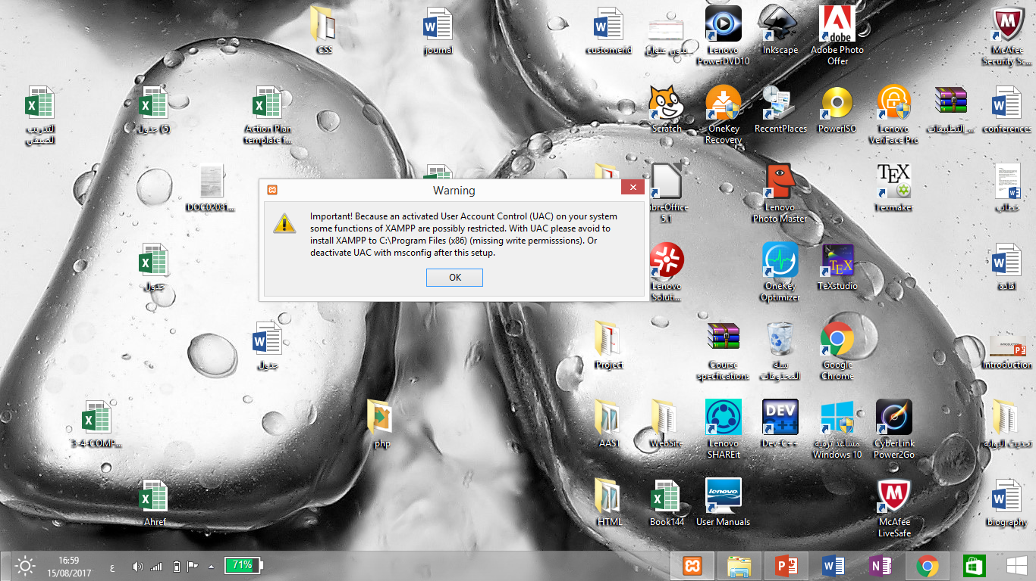

Slide 18
Basic syntax PHP tags
When PHP parses a file, it looks for opening and closing tags, which are <?php and ?> which tell PHP to start and stop interpreting the code between them.
Parsing in this manner allows PHP to be embedded in all sorts of different documents, as everything outside of a pair of opening and closing tags is ignored by the PHP parser.
If a file is pure PHP code, it is preferable to omit the PHP closing tag at the end of the file. This prevents accidental whitespace or new lines being added after the PHP closing tag.

Slide 19
Basic syntax Instruction separation
As in C or Perl, PHP requires instructions to be terminated with a semicolon at the end of each statement. The closing tag of a block of PHP code automatically implies a semicolon; you do not need to have a semicolon terminating the last line of a PHP block. The closing tag for the block will include the immediately trailing newline if one is present.
<?php echo 'This is a test'; ?> <?php echo 'This is a test' ?> <?php echo 'We omitted the last closing tag';

Slide 20
Comments
Message to everyone who reads source program and is used to document source code.
Makes the program more readable and eye catching.
Non executable statement.
Always neglected by compiler.
Can be written anywhere and any number of times.
Use as many comments as possible.

Slide 21
Comments
Single Line Comment
starts with “//” symbol.
Remaining line after “//” symbol is ignored by browser.
End of Line is considered as End of the comment.
2. Multiple Line Comment (Block Comment)
starts with “/*” symbol.
ends with “*/” symbol.

Slide 22
Comments
Example:
<?php echo 'This is a test'; // This is a one-line c++ style comment /* This is a multi line comment yet another line of comment */ echo 'This is yet another test'; echo 'One Final Test'; # This is a one-line shell-style comment ?>

Slide 23
Variables
PHP supports ten primitive types.
Four scalar types:
boolean
integer
float (floating-point number, aka double)
string

Slide 24
Variables boolean
This is the simplest type.
A boolean expresses a truth value.
It can be either TRUE or FALASE.
Both are case-insensitive.
Example:
<?php $status = True; // assign the value TRUE to $status ?>

Slide 25
Variables integer
An integer is a number of the set ℤ = {..., -2, -1, 0, 1, 2, ...}.
Integers can be specified in decimal (base 10), hexadecimal (base 16), octal (base 8) or binary (base 2) notation, optionally preceded by a sign (- or +).
To use octal notation, precede the number with a 0 (zero). To use hexadecimal notation precede the number with 0x. To use binary notation precede the number with 0b.
<?php $a = 1234; // decimal number $a = -123; // a negative number $a = 0123; // octal number (equivalent to 83 decimal) $a = 0x1A; // hexadecimal number (equivalent to 26 decimal) $a = 0b11111111; // binary number (equivalent to 255 decimal) ?>

Slide 26
Variables integer
The size of an integer is platform-dependent, although a maximum value of about two billion is the usual value (that's 32 bits signed).
There is no integer division operator in PHP. 1/2 yields the float 0.5. The value can be casted to an integer to round it towards zero, or the round() function provides finer control over rounding.
<?php var_dump(25/7); // float(3.5714285714286) var_dump((int) (25/7)); // int(3) var_dump(round(25/7)); // float(4) ?>

Slide 27
Variables float
Floating point numbers (also known as "floats", "doubles", or "real numbers")
It can be specified using any of the following syntaxes:
<?php $a = 1.234; $b = 1.2e3; $c = 7E-10; ?>

Slide 28
Variables string
A string is series of characters, where a character is the same as a byte.
A string literal can be specified in four different ways:
single quoted
double quoted
heredoc syntax
nowdoc syntax

Slide 29
Variables string
single quoted
The simplest way to specify a string is to enclose it in single quotes (the character ').
To specify a literal single quote, escape it with a backslash (\). To specify a literal backslash, double it (\\). All other instances of backslash will be treated as a literal backslash: this means that the other escape sequences you might be used to, such as \r or \n, will be output literally as specified rather than having any special meaning.

Slide 30
Variables string
single quoted
<?php echo 'this is a simple string'; // Outputs: Arnold once said: "I'll be back" echo 'Arnold once said: "I\'ll be back"'; // Outputs: You deleted C:\*.*? echo 'You deleted C:\\*.*?'; // Outputs: This will not expand: \n a newline echo 'This will not expand: \n a newline'; // Outputs: Variables do not $expand $either echo 'Variables do not $expand $either'; ?>

Slide 31
Variables string
Double quoted
If the string is enclosed in double-quotes ("), PHP will interpret the following escape sequences for special characters:
Escaped characters
Sequence | Meaning
\n | Linefeed
\t | horizontal tab
\v | vertical tab
\\ | Backslash
\$ | dollar sign
\" | double-quote

Slide 32
Variables
Four compound types:
array
object
callable
iterable
And finally two special types:
resource
NULL

Slide 33
Variables
Variables in PHP are represented by a dollar sign $ followed by the name of the variable. The variable name is case-sensitive.
Variable names follow the same rules as other labels in PHP. A valid variable name starts with a letter or underscore, followed by any number of letters, numbers, or underscores.
These are OK.
$cost $str17 $_tax
but not these:
value $17str $@^%!

Slide 34
Variables
You can use them in the usual way.
$total = $basic + $tax;
but you can also do some unusual things. What is printed when you run the following code?
$h = "hello"; $var = "h"; echo $$var;
Because $var has the value "h", PHP regards $$var as being the same thing as $h. So it prints the word hello.

Slide 35
By default, variables are always assigned by value. That is to say, when you assign an expression to a variable, the entire value of the original expression is copied into the destination variable. This means, for instance, that after assigning one variable's value to another, changing one of those variables will have no effect on the other.
PHP also offers another way to assign values to variables: assign by reference. This means that the new variable simply references (in other words, "becomes an alias for" or "points to") the original variable. Changes to the new variable affect the original, and vice versa.

Slide 36
To assign by reference, simply prepend an ampersand (&) to the beginning of the variable which is being assigned (the source variable). For instance, the following code snippet outputs 'My name is Bob' twice:
<?php $foo = 'Bob'; // Assign the value 'Bob' to $foo $bar = &$foo; // Reference $foo via $bar. $bar = "My name is $bar"; // Alter $bar... echo $bar; echo $foo; // $foo is altered too. ?>

Slide 37
It is not necessary to initialize variables in PHP however it is a very good practice. Uninitialized variables have a default value of their type depending on the context in which they are used-booleans default to FALSE, integers and floats default to zero, strings (e.g. used in echo) are set as an empty string and arrays become to an empty array.

Slide 38
Variable scope
The scope of a variable is the context within which it is defined. For the most part all PHP variables only have a single scope.
<?php $a = 1; /* global scope */ function test() { echo $a; /* reference to local scope variable */ } test(); ?>

Slide 39
Variable scope
This script will not produce any output because the echo statement refers to a local version of the $a variable, and it has not been assigned a value within this scope.
In PHP global variables must be declared global inside a function if they are going to be used in that function.

Slide 40
<?php $a = 1; $b = 2; function Sum() { global $a, $b; $b = $a + $b; } Sum(); echo $b; ?>

Slide 41
The above script will output 3. By declaring $a and $b global within the function, all references to either variable will refer to the global version.
There is no limit to the number of global variables that can be manipulated by a function.

Slide 42
Variable variables
Sometimes it is convenient to be able to have variable variable names. That is, a variable name which can be set and used dynamically. A normal variable is set with a statement such as:
<?php $a = 'hello'; ?>

Slide 43
Variable variables
A variable variable takes the value of a variable and treats that as the name of a variable. In the above example,hello, can be used as the name of a variable by using two dollar signs. i.e.
<?php $$a = 'world'; ?>

Slide 44
Variable variables
At this point two variables have been defined and stored in the PHP symbol tree: $a with cont
<?php echo "$a ${$a}"; ?>ents "hello" and$hello with contents "world". Therefore, this statement:
produces the exact same output as:
<?php echo "$a $hello"; ?>
i.e. they both produce: hello world.

Slide 45
Output
Output from a PHP script is HTML that is sent to the browser.
There are three ways to produce output: echo, print, and printf

